Slide 1
Chebyshev’s Walking Mechanism
Plantigrade Mechanism
M Shiva Sai
K Sai Teja
M Hitesh

Slide 2
Chebyshev’s lambda mechanism

Slide 3
Chebyshev’s Walking Mechanism
Four-bar mechanism.
Converts rotational motion to approximate straight-line motion with approximate constant velocity.
Also called lambda mechanism due to it’s resemblance with Greek letter Lambda(λ).

Slide 4
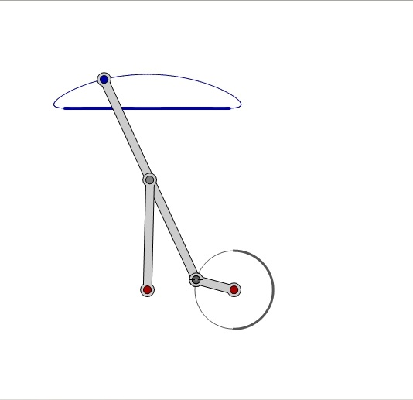

Slide 5
Invented by Pafnuty Chebyshev.
It is the fundamental unit of Chebyshev’s walking machine.
Also called as HOECKEN’S linkage. [ Leg mechanism, Straight line mechanism ].

Slide 6
Mobility
Mobility = 3(n-j-1)+j
where,
n = no. of links = 4,
j = no. of joints = 4.
Mobility = 3(4-4-1)+4 = 1 .
MOBILITY = 1 .

Slide 7


Slide 8
Applications
In making of walking Robots.
Construction of Rovers.
Working of mechanical toys.
In devices, for obtaining rectilinear motion without use of guides.

Slide 9
Thank You

